Slide 1
20240914 Condensed matter physics: from magnetism to quantum spin liquid II
Sophia University Ryui Kaneko （金子隆威）
https://github.com/ryuikaneko/lecturenote_2024_condmat

Slide 2
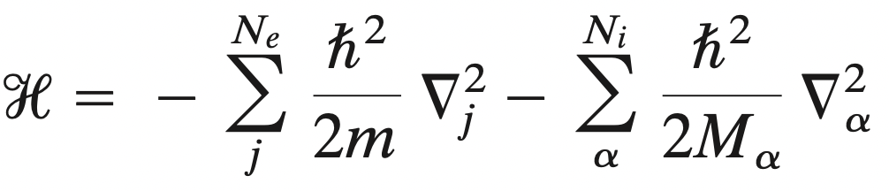
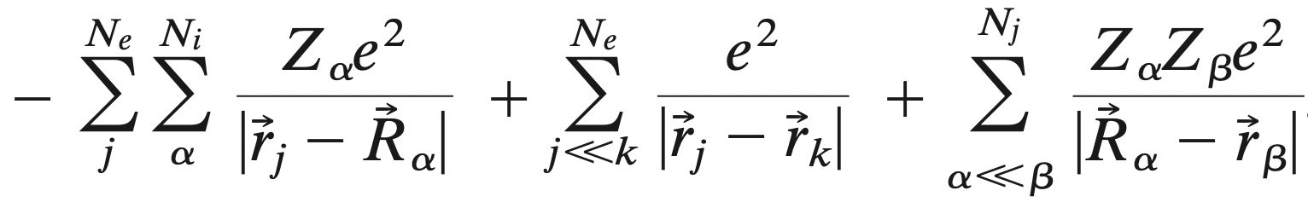
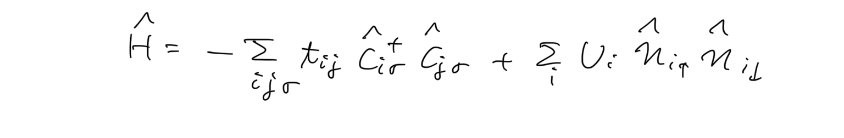

Rough outline
Hamiltonian for electrons in atoms
Hubbard model
Heisenberg model
magnetism, quantum spin liquid, …

Slide 3
Outline
Brief review of itinerant electron systems
Electrons in crystals
Second quantization
Hubbard models
Solving models for simple cases
Noninteracting and atomic limits
Mean-field approximation
Exact diagonalization (2 sites)
→ Strong coupling limit: Heisenberg model (spin system)
Magnetism and quantum spin liquid
Spin models
Frustrated magnetism and quantum spin liquid
Kitaev honeycomb spin liquid

Slide 4
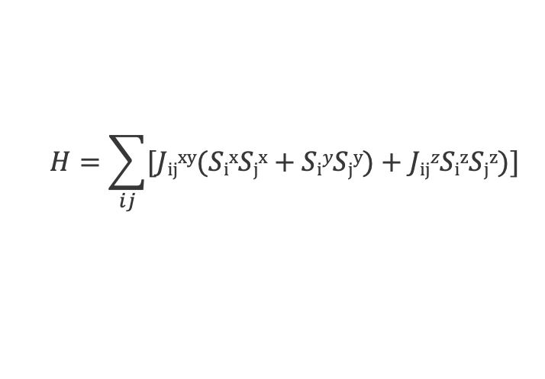
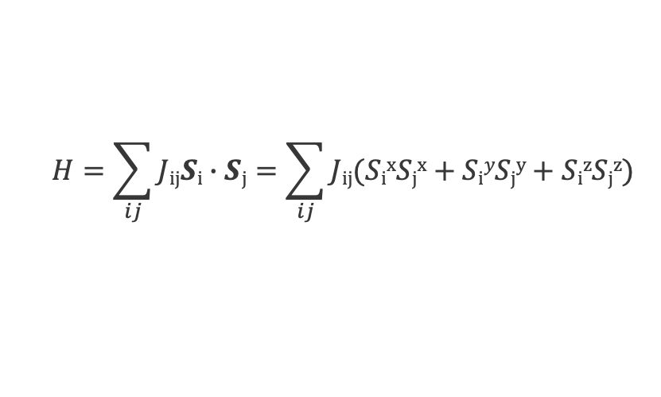
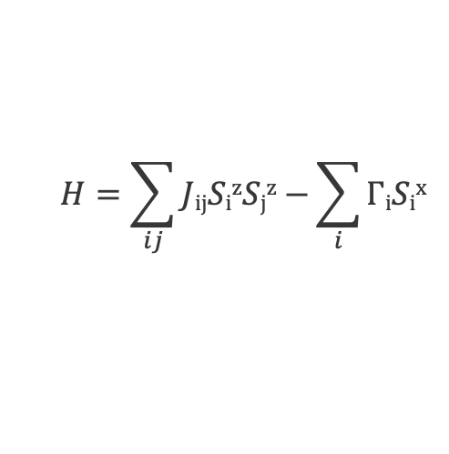
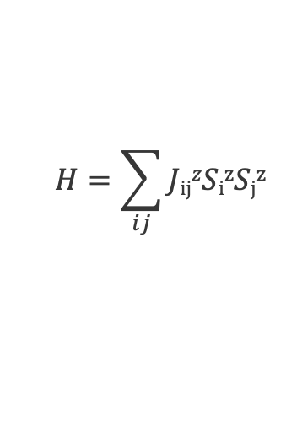
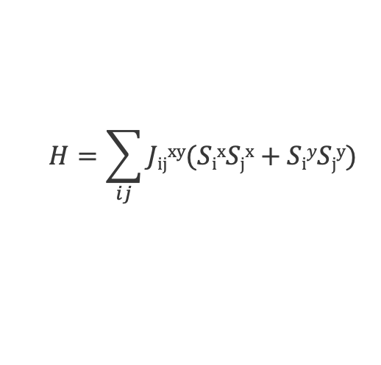
Spin models
Heisenberg model
XXZ model
XY model (J_{ij}^{z}=0)
Classical Ising model (J_{ij}^{xy}=0)
Transverse-field Ising model
$$H=\sum_{ij}{JijSi∙Sj}=\sum_{ij}{Jij(SixSjx+SiySjy+SizSjz)}$$
$$H=\sum_{ij}{[Jijxy(SixSjx+SiySjy)+JijzSizSjz)}]$$
$$H=\sum_{ij}{Jijxy(SixSjx+SiySjy)}$$
$$H=\sum_{ij}{JijzSizSjz}$$
$$H=\sum_{ij}{JijSizSjz−}\sum_{i}{ΓiSix}$$

Slide 5
Mermin-Wagner theorem
Continuous symmetries cannot be spontaneously broken at finite temperature in systems with sufficiently short-range interactions in dimensions D<=2.
N. D. Mermin and H. Wagner, PRL.17.1133 (’66)
Spatial dimension | Tc>0?
1D | x
2D | x
3D | ✔
4D | ✔
… | …
Magnetic order
T_{c}>0
T

Slide 6
Mermin-Wagner theorem
Continuous symmetries cannot be spontaneously broken at finite temperature in systems with sufficiently short-range interactions in dimensions D<=2.
Note 1: Of course, discrete symmetries can be spontaneously broken even in D=2 (e.g., Tc>0 in 2D Ising models).
Note 2: MW theorem does not state anything about the topological phase transition (e.g., Berezinskii-Kosterlitz-Thouless (BKT) transition occurs in systems with U(1) symmetry in 2D).
N. D. Mermin and H. Wagner, PRL.17.1133 (’66)

Slide 7
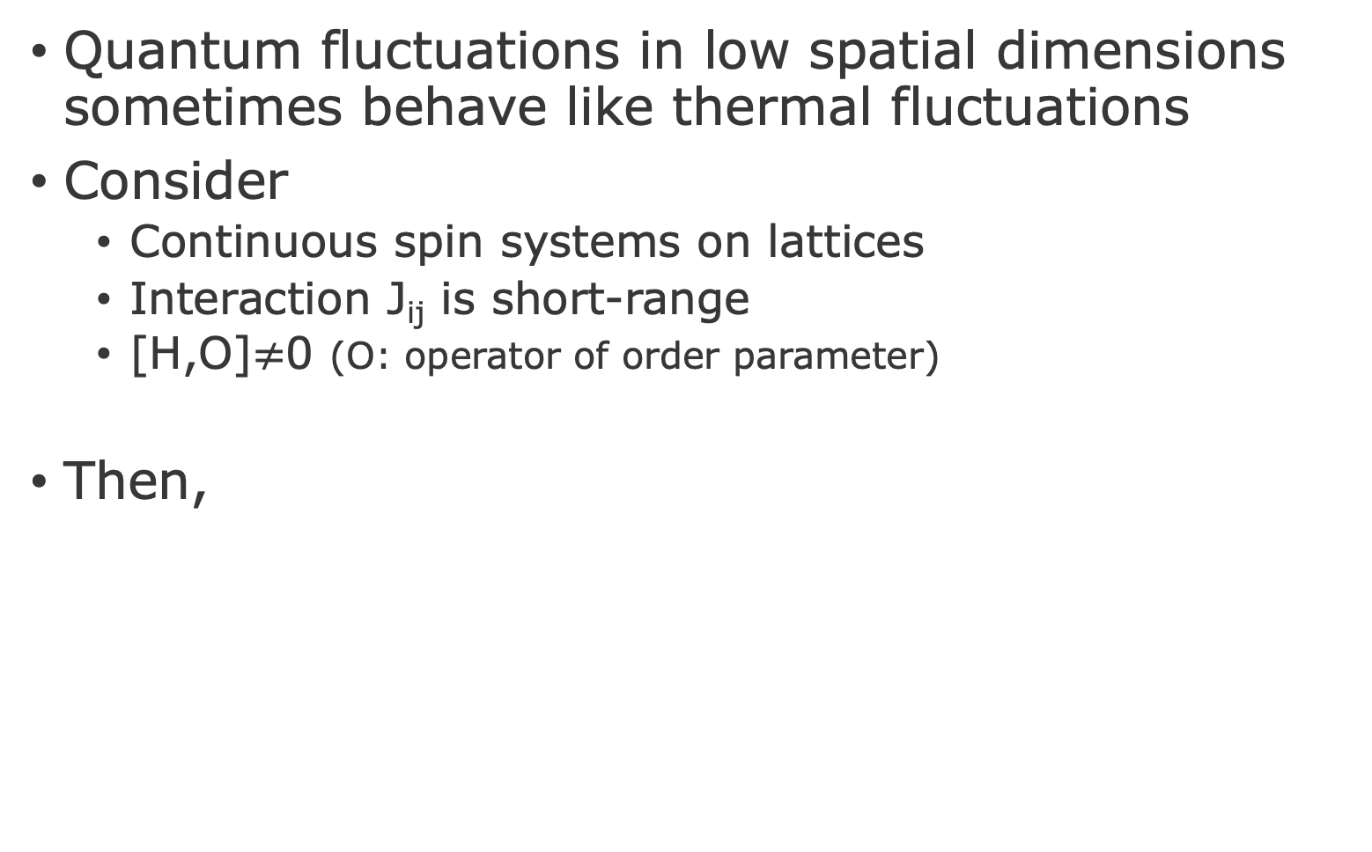
“Mermin-Wagner theorem” at T=0
Quantum fluctuations in low spatial dimensions sometimes behave like thermal fluctuations
Consider
Continuous spin systems on lattices
Interaction J_{ij} is short-range
[H,O]$≠$0 (O: operator of order parameter)
Then,
Magnetic order
Quantum
fluctuations
Spatial dimension | Magnetic Long-range order at T=0?
1D | x
2D | ✔
3D | ✔
… | …
L. Pitaevskii and S. Stringari, JLowTempPhys.85.377(’91)

Slide 8
“Mermin-Wagner theorem” at T=0
Quantum fluctuations in low spatial dimensions sometimes behave like thermal fluctuations
Consider
Continuous spin systems on lattices
Interaction J_{ij} is short-range
Hamiltonian is not frustration-free
(c.f. For more rigorous argument, see H. Watanabe et al., arXiv:2310.16881)
Then,
Magnetic order
Quantum
fluctuations
Spatial dimension | Magnetic Long-range order at T=0?
1D | x
2D | ✔
3D | ✔
… | …
L. Pitaevskii and S. Stringari, JLowTempPhys.85.377(’91)

Slide 9
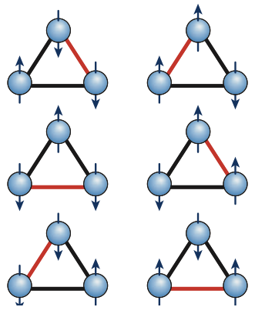
No long-range order even in 2D, 3D at T=0?
Example 1: Classical triangular Ising model
Consider antiferromagnetic (AF) interaction J>0
For 3 sites, degenerate ground states
For infinite sites, spin correlation shows power-law decay at T=0 <S₀S_{r}>~r^{-η} (η=1/2)
But no long-range order Σ_{i}exp(iQr_{i})<S_{i}>=0 (Q=(2π/3,2π/3))
J. Stephenson, J.Math.Phys.11.413 (’70);
S. Alexander and P. Pincus, J.Phys.A:Math.Gen.13.263 (’80)
Geometrical frustration

Slide 10
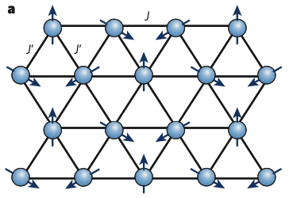
No long-range order even in 2D, 3D at T=0?
Example 2: Classical triangular Heisenberg model
(ordered case)
120 Neel order
at T=0

Slide 11
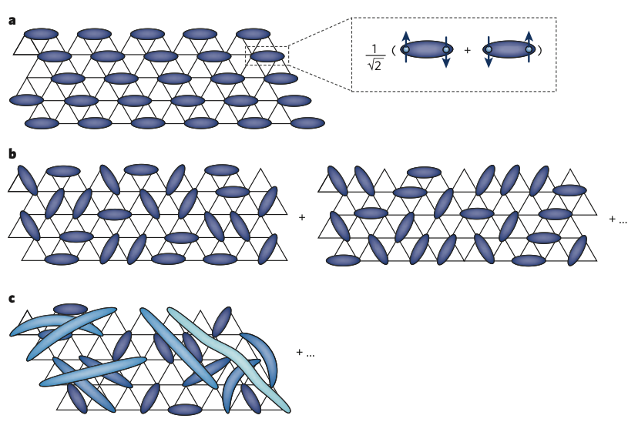
No long-range order even in 2D, 3D at T=0?
In quantum spin 1/2 triangular Heisenberg model
Ground state has no magnetic order?!
P. W. Anderson
“Resonating valence bonds: a new kind of insulator”
Mater. Res. Bull. 8, 153–160 (1973)
L. Balents, Nature.464.199(’10)
Example of a singlet dimerized state

Slide 12
No long-range order even in 2D, 3D at T=0?
In quantum spin 1/2 triangular Heisenberg model
L. Balents, Nature.464.199(’10)
Dimer order is also absent?
Dimer dynamically moves?
Resonating valence bond state
(RVB state)

Slide 13
No long-range order even in 2D, 3D at T=0?
In quantum spin 1/2 triangular Heisenberg model
Unfortunately, it is now widely believed that the true ground state has long-range magnetic order
Exact diagonalization
B. Bernu et al., PRB.50.10048(’94)
Variational Monte Carlo (VMC)
L. Capriotti et al., PRL.82.3899 (’99)
Density matrix renormalization group (DMRG)
S. White and A. L. Chernyshev, PRL.99.127004(’07)
Σ_{i}exp(iQr_{i})<S_{i}>/S_{max}=0.41(3) (Q=(2π/3,2π/3), S_{max}=1/2)

Slide 14
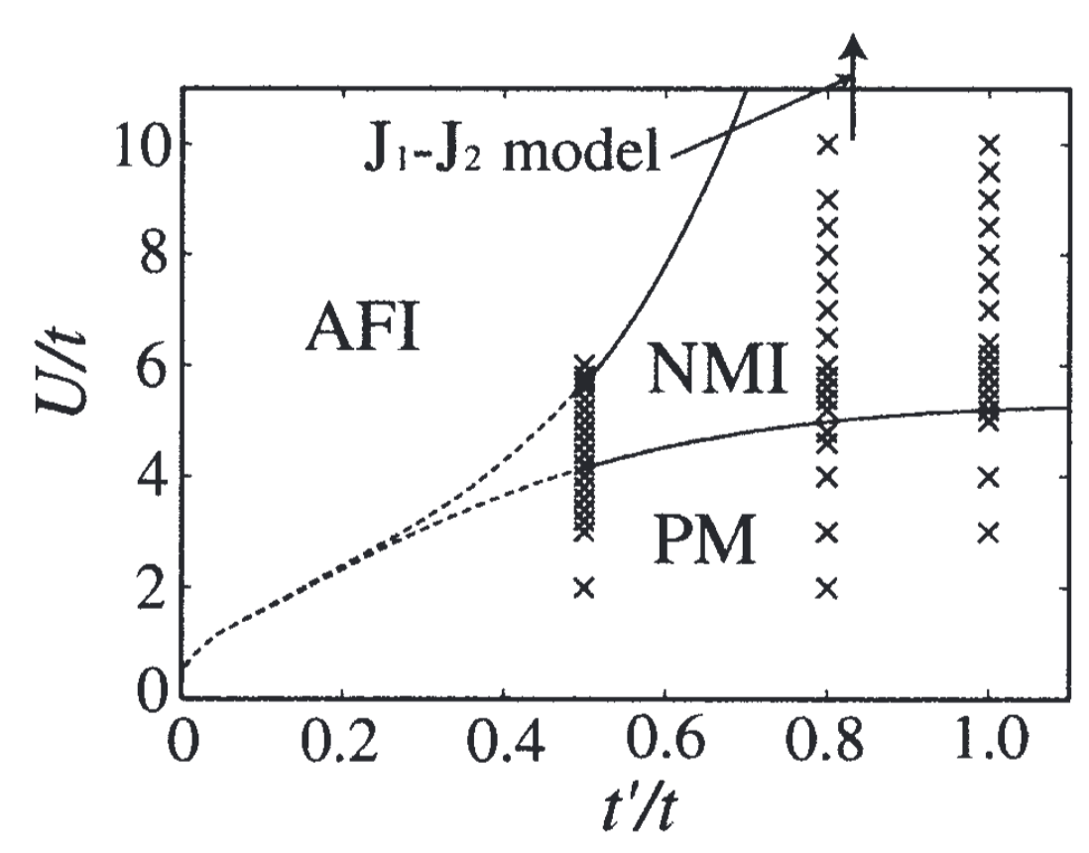
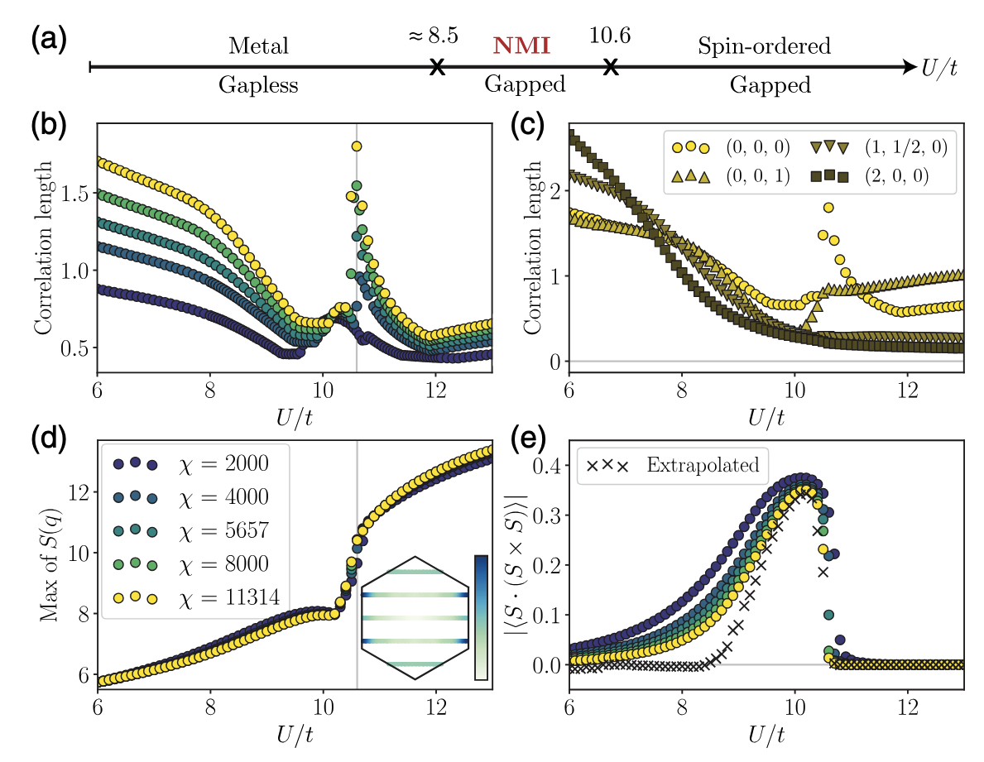
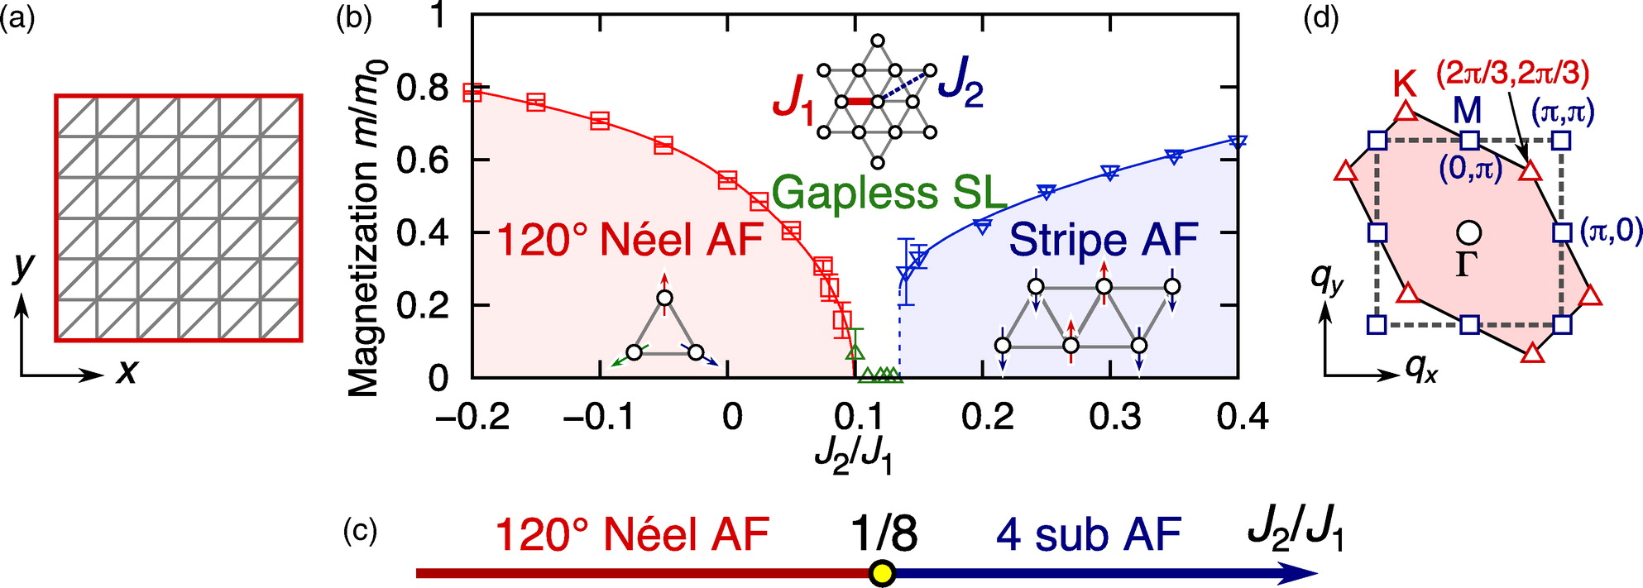
To realize quantum spin liquid…
Effects of charge fluctuations
Effects of next-nearest-neighbor interaction
And so on…
H. Morita et al., JPSJ.71.2109 (’02)
A. Szasz et al., PRX.10.021042 (’20)
R. Kaneko et al., JPSJ.83.093707 (’14)

Slide 15
Quantum spin liquid (QSL)
No long-range order of spin, dimer, …
Insulating (charge excitation: open)
Metal shows no order, but it is not quantum spin liquid
Characterized by spin excitation (for N_{s}→∞)
Open: Gapped spin liquid
Often characterized by topological entanglement entropy
Closed: Gapless spin liquid
Sometimes characterized by spinon pairing symmetry
(just as in the case of pairing symmetry in superconductors)
A. kitaev and J. Preskill, PRL.96.110404 (’06)
M. Levin and X.-G. Wen, PRL.96.110405 (’06)
Y. Zhang et al., PRL.107.067202(’11)
S=1
nonzero
…
continuous
S=0
S=2
S=1
S=0

Slide 16
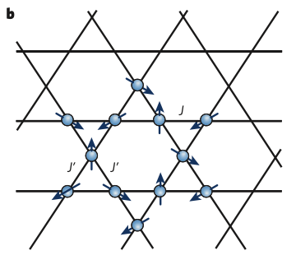
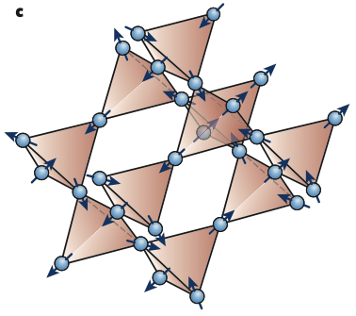
Example? Candidate materials?
Triangular lattice
Organic compounds
κ-(BEDTTTF)₂Cu₂(CN)₃
EtMe₃Sb[Pd(dmit)₂]₂
Antiferromagnets
YbMgGaO₄
Kagome lattice
Antiferromagnets
Herbertsmithite
Volborthite
Vesignieite
Kapellasite
Pyrochlore lattice
Antiferromagnets
Tb₂Hf₂O₇, Tb₂Hf₂O₇, Ce₂Zr₂O₇, …

Slide 17
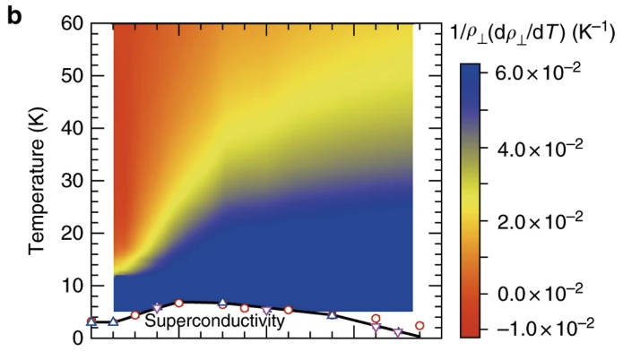
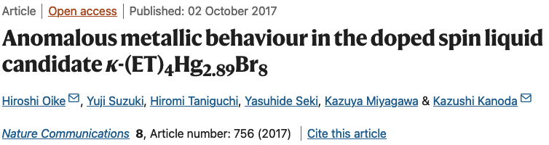
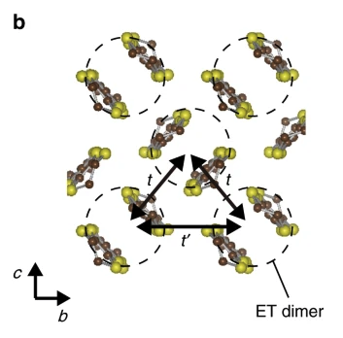
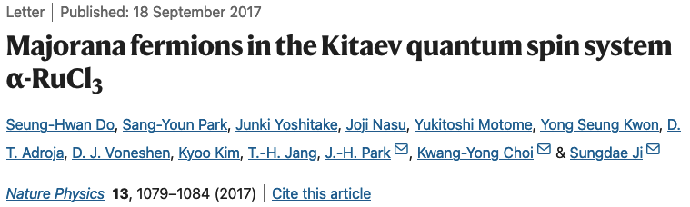
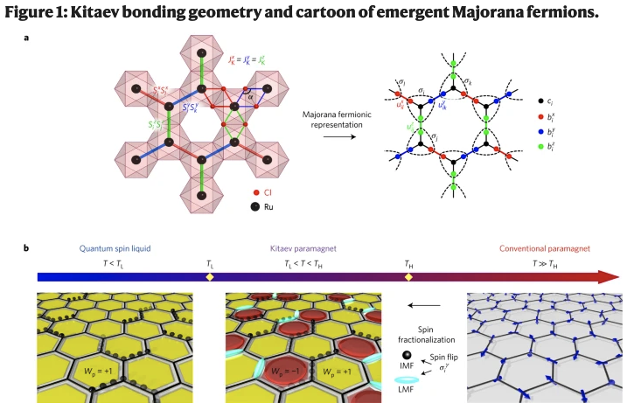
Why do we study QSL?
Related to superconductivity (SC)
Doping QSL → High T_{c} SC?
Quantum computation
Using Majorana fermion in Kitaev spin liquid
(Just for fun)
Unconventional quasiparticles, statistics, …

Slide 18
Difficulty in searching for QSL theoretically
However, no analytical solution
Exception 1: “QSL” in 1D (Tomonaga-Luttinger liquid)
Exception 2: Kitaev QSL in 2D
Mean-field approximation is not applicable
Any order parameter is 0
No universal numerical methods
Exact diagonalization: Size too small
Quantum Monte Carlo method: Negative sign problem
We often use variational Monte Carlo and Tensor-network methods

Slide 19
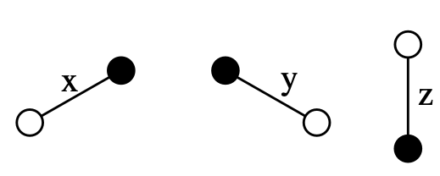
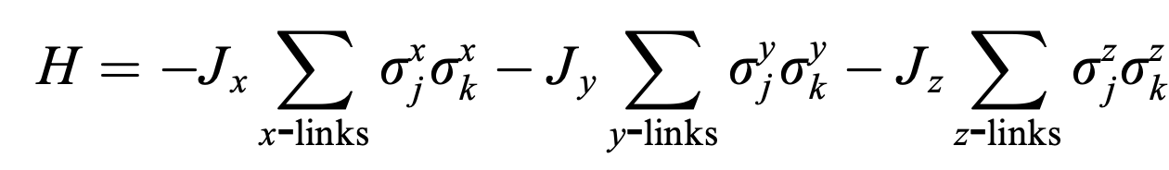
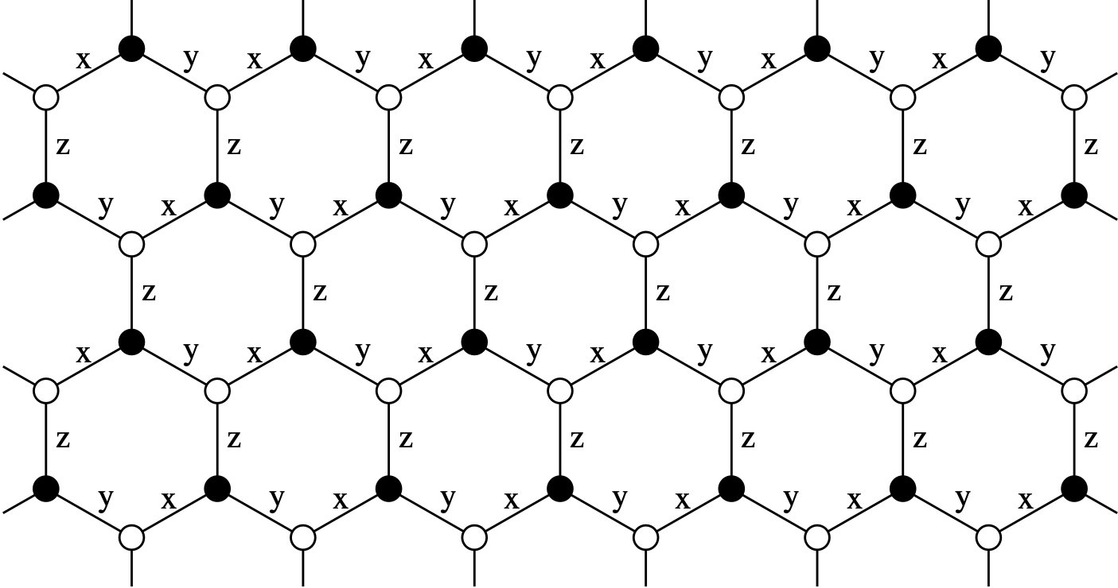
Kitaev QSL (rare example of solvable QSL)
Model
Bond-dependent
Ising interaction
A. kitaev, AnnPhys.321.2 (’06)

Slide 20
Kitaev QSL (rare example of solvable QSL)
Intuitive understanding (bond frustration)
S^{z}
S^{y}
S^{x}

Slide 21
Kitaev QSL (rare example of solvable QSL)
Common way of solving the problem
Using conserved quantities,
extending the Hilbert space (original way)
[A. Kitaev, AnnPhys.321.2(’06)]
Apply Jordan-Wigner transformation
[X.-Y. Feng et al., PRL.98.087204(’07); H.-D. Chen and J. Hu, PRB.76.193101(’07); H.-D. Chen and Z. Nussinov, JPhysA:MathTheor.41.075001(’08); S. Mandal et al., JPhysA:MathTheor.45.335304(’12)]
Similar to the original way,
but without extending the Hilbert space
[J. Fu et al., PRB.97.115142 (’18)]
Focus on the original way

Slide 22
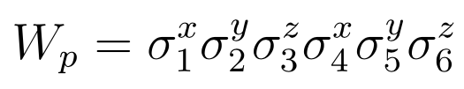
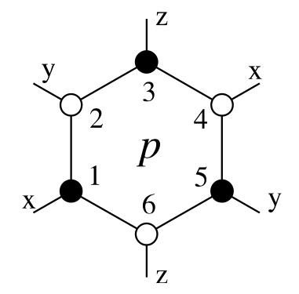
Kitaev QSL (rare example of solvable QSL)
Conserved quantities
After some tedious calculations,
we obtain
[H,W_{p}]=0 for all p
[W_{p},W_{p’}]=0 for all p, p’
W_{p}²=1 → W_{p}=+1 or -1
Describe eigenstates of H using eigenstates of W_{p}

Slide 23
Kitaev QSL (rare example of solvable QSL)
Enlarge Hilbert space using Majorana fermions
(c=c†)
Original spin basis
Enlarged Hilbert space
After projection
|↑>
|00>
D=(2c₁†c₁-1)(2c₂†c₂-1)
P=(1+D)/2
|00>
|01>
D=(2*0-1)(2*1-1)=-1
P=0
Disappear
Unphysical
|10>
D=(2*1-1)(2*0-1)=-1
P=0
Disappear
|↓>
|11>
|11>
σ^{x}, σ^{y}, σ^{z}
c=c₁†+c₁, b^{x}=i(c₁†-c₁), b^{y}=c₂†+c₂, b^{z}=i(c₂†-c₂)
Solve the problem in the enlarged Hilbert space
and finally apply the projection to obtain the physical state

Slide 24
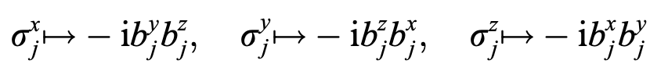
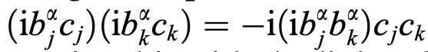
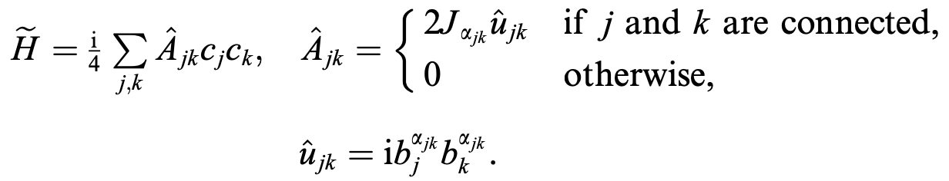
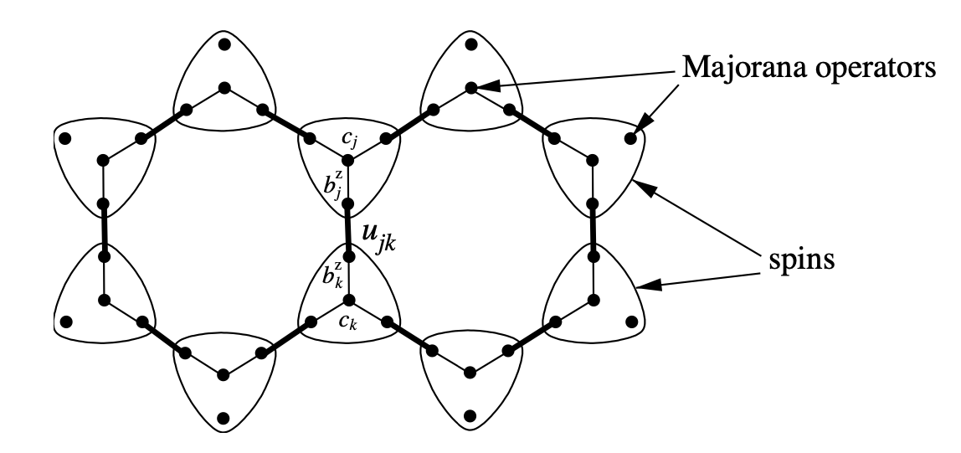
Kitaev QSL (rare example of solvable QSL)
Enlarge Hilbert space using Majorana fermions
Quadratic-“like”
Hamiltonian
Looks not free
because of u_{jk}

Slide 25
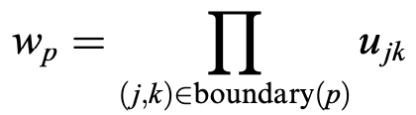
Kitaev QSL (rare example of solvable QSL)
It IS actually a quadratic Hamiltonian
After some tedious calculations, we obtain
u_{jk}=-u_{kj}
[H,u_{jk}]=0 for all j, k
[u_{jk},u_{j’k’}]=0 for all j, k, j’, k’
u_{jk}²=1 → u_{jk}=+1 or -1
The role of u_{jk} and W_{p} is the same
Quadratic Hamiltonian
because u_{jk} is just a number

Slide 26
Kitaev QSL (rare example of solvable QSL)
Configuration of u_{jk}?
According to Lieb’s theorem,
u_{jk}=+1 (W_{p}=+1) for all j, k (p) in the ground state
Often called “flux free” or “Vortex free”
[E. H. Lieb, PRL.73.2158 (’94)]
+1
+1
+1
+1
+1
+1
+1
+1
+1
+1
+1
+1
+1
+1
+1
+1
+1
+1
+1

Slide 27
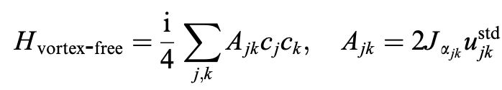
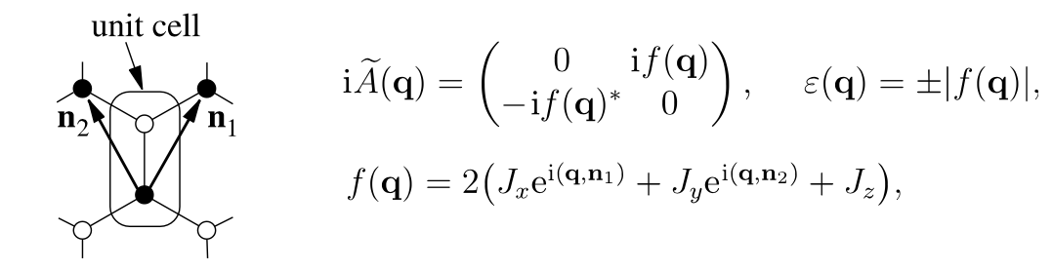
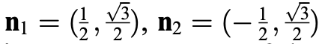
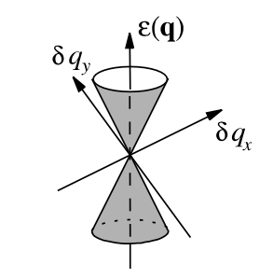
Kitaev QSL (rare example of solvable QSL)
Spectrum of the quadratic Hamiltonian
When J_{x}~J_{y}~J_{z},
Dirac cone dispersion appears

Slide 28
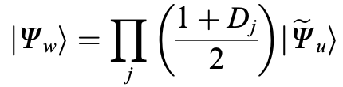
Kitaev QSL (rare example of solvable QSL)
Reduce enlarged Hilbert space:
Project out unphysical states
Projection operator commutes with Hamiltonian!!
P=(1+D)/2
[H,P]=0
As for the energy spectrum, we do not need to care about the projection
As for the eigenstate,

Slide 29
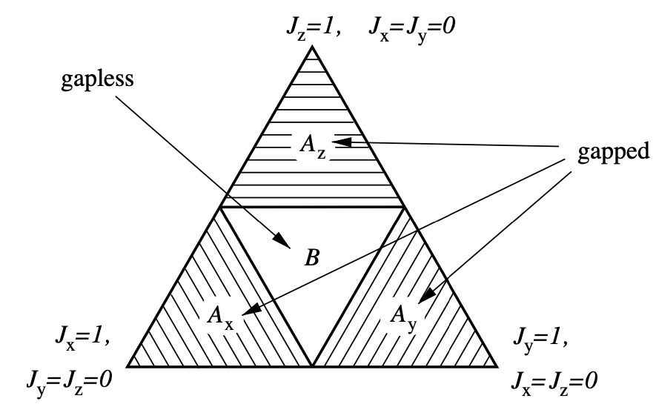
Kitaev QSL (rare example of solvable QSL)
Ground state phase diagram

Slide 30
Kitaev QSL (rare example of solvable QSL)
Short-range spin correlation
Applying σ^{α} flips the flux
W_{p}σ^{x}₁=+σ^{x}₁W_{p} (commute)
W_{p}σ^{y}₁=-σ^{y}₁W_{p} (anticommute)
W_{p}σ^{z}₁=-σ^{z}₁W_{p} (anticommute)
W_{p}σ^{y}₁|eigenstate(+1)>=-σ^{y}₁W_{p}|eigenstate(+1)>=-σ^{y}₁|eigenstate(+1)>
+1
σ^{x}₁
-1
σ^{y}₁
σ^{z}₁
-1

Slide 31
Kitaev QSL (rare example of solvable QSL)
Short-range spin correlation
|ψ_{i}>=σ^{x}_{i}|ψ>
Different flux sector
Orthogonal each other
|ψ_{j}>=σ^{x}_{j}|ψ>
+1
+1
+1
+1
+1
+1
+1
+1
+1
+1
-1
+1
+1
-1
+1
+1
+1
+1
+1
+1
+1
+1
+1
+1
σ^{x}_{j}
-1
+1
σ^{x}_{i}
+1
+1
+1
-1
+1
+1
+1
+1
+1
+1
+1
+1
<ψ_{i}|ψ_{j}>=0 → <ψ|σ^{x}_{i} σ^{x}_{j}|ψ>=0
Spin correlation is 0 except i and j on the same bond
for all eigenstates |ψ>
Short-range QSL for any eigenstates
[G. Baskaran et al., PRL.98.247201 (’07)]

Slide 32
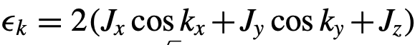
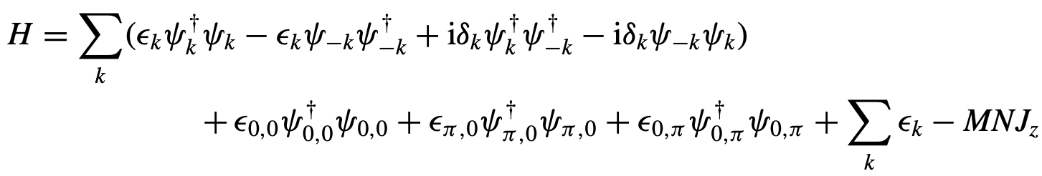
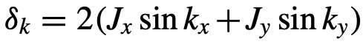
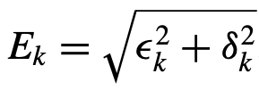
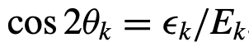
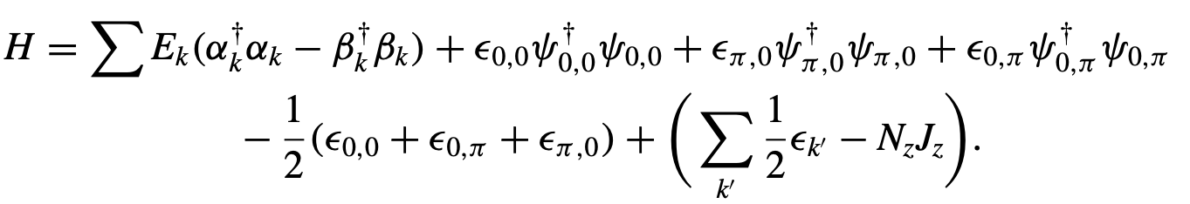
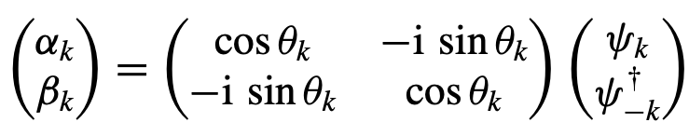
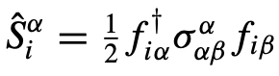
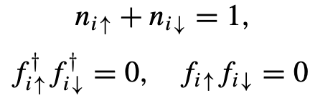
Kitaev QSL (rare example of solvable QSL)
Relation to superconductivity
Solution by Jordan-Wigner transformation on a torus
p-wave superconductor (but with projection)
This is also the case for SU(2) slave fermion formalism (although SU(2) slave fermion formalism is an approximation)
[F. J. Burnell and C. Nayak, PRB.84.125125(‘11); S. Mandal et al., JPhysA:MathTheor.45.335304(’12)]

Slide 33
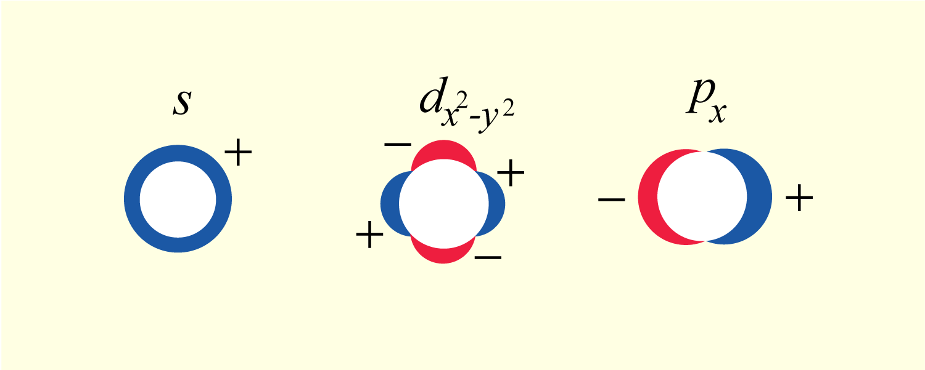
Kitaev QSL (rare example of solvable QSL)
Relation to superconductivity
Solution by Jordan-Wigner transformation on a torus
p-wave superconductor (but with projection)
This is also the case for SU(2) slave fermion formalism (although SU(2) slave fermion formalism is an approximation)
[F. J. Burnell and C. Nayak, PRB.84.125125(‘11); S. Mandal et al., JPhysA:MathTheor.45.335304(’12)]
+exp(+ikx)-exp(-ikx) = 2 i sin(kx)
Taken from https://zvine-ap.eng.hokudai.ac.jp/~asano/research.html

Slide 34
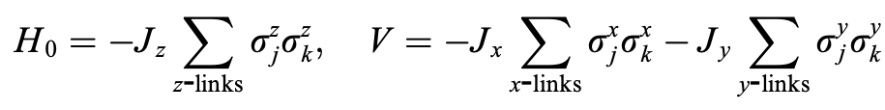
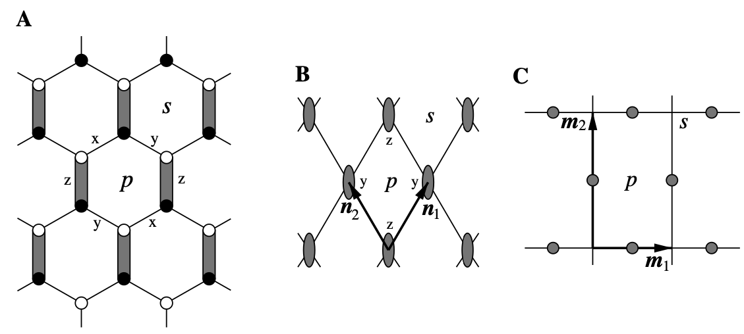

Kitaev QSL (rare example of solvable QSL)
Relation to Toric code model
Consider large J_{z} limit

Slide 35





Kitaev QSL (rare example of solvable QSL)
Relation to Toric code model
Unitary transformation

Slide 36


Kitaev QSL (rare example of solvable QSL)
Relation to Toric code model
Original motivation seems to be quantum computation
Strongly influences the field of condensed matter physics
1997:
Toric code model
↓
2005:
Kitaev honeycomb model
(Toric code model and RVB states are mentioned in introduction)

Slide 37

What is unconventional about Kitaev QSL?
(in my opinion)
It is often the case that
Gapped QSL → Short-range magnetic order
<S₀.S_{r}>~exp(-r/ξ)
Gapless QSL → Quasi-long-range magnetic order
<S₀.S_{r}>~r^{-η}
In Kitaev QSL
Gapless QSL → Short-range magnetic order
<S₀.S_{r}>~exp(-r/ξ)
(Because spin rotational symmetry is explicitly broken and total spin is not a good quantum number in Kitaev model)
In contrast, dimer-dimer correlation
shows quasi-long-range order
[S. Yang et al., PRA.78.012304 (’08)]

Slide 38
What is unconventional about Kitaev QSL?
(in my opinion)
It is often the case that
Only low-energy states exhibit QSL behavior
At high temperatures, we cannot see QSL behavior
In Kitaev QSL
All the eigenstates are QSL
QSL behavior (short-range spin correlations) even at high temperatures
[G. Baskaran et al., PRL.98.247201 (’07)]
QSL behavior in real-time dynamics as well
[A. Lavasani et al., PRB.108.115135 (’23)]
It can also be extended to general spin S
[G. Baskaran et al., PRB.78.115116 (’08)]

Slide 39




Candidate material
edge-shared octahedra
Consider Hubbard-type model with spin-orbit interaction
Just as in the case of obtaining Heisenberg model, consider large U limit
Candidates:
Sr₂IrO₄, Na₂IrO₃, α-RuCl₃, …

Slide 40


Candidate material
Ground state actually shows magnetic order
At low temperatures, it exhibits QSL-like behavior

Slide 41



Candidate material
Find QSL under magnetic field

Slide 42

Candidate material
Find QSL under magnetic field

Slide 43



Candidate “material”
Ultracold atoms in optical lattices, Rydberg atom arrays

Slide 44
Recent topics (my research)
How to efficiently represent Kitaev gapless QSL using tensor network?
Gapless state
Often logarithmic correction in entanglement entropy
1D tensor network (matrix product state) is not good at representing gapless states
2D tensor network (projected entangled pair state (PEPS) / tensor product state)
Do not prohibit efficient description of gapless states
(e.g. criticality of 2D classical Ising model by D_{bond}=2)
[see R. Orus, AnnPhys.349.117(’14)]
Honeycomb gapless spin liquid
Spinon Dirac dispersion → no logarithmic correction
[see Y. Zhang et al., PRL.107.067202(’11)]

Slide 45
Recent topics (my research)
PEPS
Efficiently describe “2D classical Ising”-like gapless state
Kitaev gapless QSL
“2D classical Ising”-like in a sense that solvable by Jordan-Wigner transformation (quantum 1D Ising-like)
Gapless but no log correction in entanglement
Is there any efficient PEPS representation of Kitaev gapless QSL?
Yes!
[H. Y. Lee et al., PRL.123.087203(’19)]
c.f. Representation in fermion basis: [P. Schmoll and R. Orus, PRB.95.045112(’17)]
We are interested in representation in spin basis

Slide 46

Recent topics (my research)

Slide 47

Recent topics (my research)

Slide 48

Recent topics (my research)

Slide 49



Recent topics (my research)

Slide 50
Today’s summary
Brief review of itinerant electron systems
Electrons in crystals
Second quantization
Hubbard models
Solving models for simple cases
Noninteracting and atomic limits
Mean-field approximation
Exact diagonalization (2 sites)
→ Strong coupling limit: Heisenberg model (spin system)
Magnetism and quantum spin liquid
Spin models
Frustrated magnetism and quantum spin liquid
Kitaev honeycomb spin liquid
https://github.com/ryuikaneko/lecturenote_2024_condmat

